Slide 1
Algorithm Analysis

Slide 2
Goals
Understand and describe the concept of computational complexity as opposed to human complexity
Describe the difference between a-priori analysis and a-posteriori observation of algorithm performance
Describe what is meant by the use of Big (O) notation
Learn the Big (O) complexity of a variety of algorithms and why they are what they are
Understand how to analyze a new algorithm for computational complexity

Slide 3
Algorithm Analysis
The study of the growth of computational (versus human) complexity as some measure of the algorithm grows large without bound.
Why study algorithm development and performance?
  Algorithm conceptualization and design is a foundational part of our field
  Scalability – the growth in computational complexity as some measure of the algorithm grows provides insight into whether or not the algorithm is scalable
  Such analyses provide indication of what is feasible and what is impossible
  The mathematics of algorithms provides a language that enables us to talk about program behavior
  The lessons of program performance generalize to other computing resources.

Slide 4
The Big Oh Notation
Definitions:
1. Asymptotics is the study of functions of a parameter n, as n becomes larger and larger without bound.
2. If f(n) and g(n) are functions defined for positive integers, then to write
f(n) is O(g(n))
means that there exists a constant c such that
|f(n)| ≤ c|g(n)|
for all sufficiently large positive integers n.
••• Under these conditions we say that "f(n) has order at most g(n)" or "f(n) grows no more rapidly than g(n)."

Slide 5
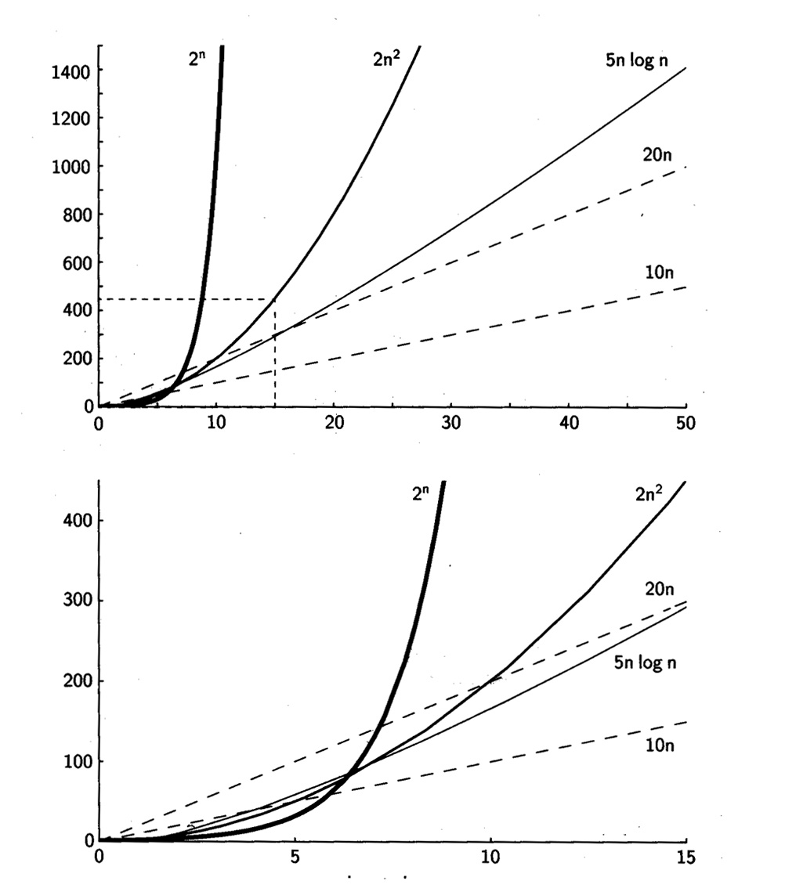
Graphs of the Growth of
Computational Complexity

Slide 6
Common Orders
  O(1): Hashing function
  O(n): Sequential search
  O(n²): Simple sorts
  O(2^{n}): Towers of Hanoi
  O(lg n): Binary Search
  O(n lg n ): Quicksort
When n gets large enough a Θ(n²) algorithm always beats a Θ(n³) algorithm
n₀

Slide 7
Computational Complexity
Some principles:
1. Constant factors don't matter
For any positive constant d and any function T(n), T(n) is O(dT(n)), regardless of whether d is a large number or a very small fraction, as long as d > 0.
2. Low-order terms don't matter
Suppose T(n) is a polynomial of the form
where ak is positive. We can throw away all terms but the first and ignore the constant ak, replacing it by 1.
a
n
k
+
a
n
k
–1
+...+
a
n
2
+
a
n
+
a
k
k
–1
2
1
0

Slide 8

Amortized Complexity Analysis
If a data structure is subject to a series of operations, some may have impact on subsequent ones.
Assessing runtime:
  Worst case for a sequence is the sum of the worst cases for each individual operation
  C(op₁, op₂, … , op_{n}) = C_{worst}(op₁) + C_{worst}(op₂) + … + C_{worst}(op_{n})
  Average complexity is the sum of the average complexity of an individual operation
  C(op₁, op₂, … , op_{n}) = C_{avg}(op₁) + C_{avg}(op₂) + … + C_{avg}(op_{n})
  Amortized complexity views what has happened so far
  C(op₁, op₂, … , op_{n}) = C(op₁) + C(op₂) + … + C(op_{n})
Examples:
  Sorting an almost-sorted list
  Adding an item to an ArrayList
It is generally too complex to determine amortized complexity by the above definition

Slide 9
Amortized Complexity
Approach: determine a Cost function C that can be applied to each operation
  Fast operations are “overcharged” – allowing the accumulation of credits to pay for slow (or computationally expensive) operations
  Slow Operations are “undercharged” (same cost for all, fast or slow)
  The cost function must overcharge the fast operations enough to pay for the expensive ones
Potential – reserves available from overcharging the fast operations. An accounting device to help us keep track of the state of the computation as part of determining the amortized cost
At each step:
T_{amortized} = T_{actual} + ΔPotential

Slide 10
Amortized Cost
Example: adding an element to an ArrayList
  Best case: O(1)
  Worst Case: O(n) // where n is the current size
Relative frequency of each of these operations is a function of the increment in the ArrayList size upon resize operation
Assume: we double the size of the ArrayList each time it is full and a push() is needed
Possible amortized costs:
  amCost(push(x)) = 1
  amCost(push(x)) = 2
  amCost(push(x)) = 3
Which is reasonable?

Slide 11
Amortized Complexity
  amCost(push(x)) = 2
Size | Capacity | Am Cost | Cost | Units Left
0 | 0
1 | 1 | 2 | 0 + 1 | 1
2 | 2 | 2 | 1 + 1 | 1
3 | 4 | 2 | 2 + 1 | 0
4 | 4 | 2 | 1 | 1
5 | 8 | 2 | 4 + 1 | -2
6 | 8 | 2 | 1 | -1
7 | 8 | 2 | 1 | 0
8 | 8 | 2 | 1 | 1
9 | 16 | 2 | 8 + 1 | -6
10 | 16 | 2 | 1 | -5
. . . | . . . | . . . | . . . | . . .
16 | 16 | 2 | 1 | 1
17 | 32 | 2 | 16 + 1 | -14
18 | 32 | 2 | 1 | -13
. . . | . . . | . . . | . . . | . . .

Slide 12
Amortized Complexity
  amCost(push(x)) = 3
Size | Capacity | Am Cost | Cost | Units Left
0 | 0
1 | 1 | 3 | 0 + 1 | 2
2 | 2 | 3 | 1 + 1 | 3
3 | 4 | 3 | 2 + 1 | 3
4 | 4 | 3 | 1 | 5
5 | 8 | 3 | 4 + 1 | 3
6 | 8 | 3 | 1 | 5
7 | 8 | 3 | 1 | 7
8 | 8 | 3 | 1 | 9
9 | 16 | 3 | 8 + 1 | 3
10 | 16 | 3 | 1 | 5
. . . | . . . | . . . | . . . | . . .
16 | 16 | 3 | 1 | 17
17 | 32 | 3 | 16 + 1 | 3
18 | 32 | 3 | 1 | 5
. . . | . . . | . . . | . . . | . . .

Slide 13
Amortized Complexity
Amortized complexity is applicable if the worst case for an operation is different than the best case and the worst case cannot happen repeatedly.
Amortized bounds are weaker than corresponding worst-case bounds
Amortized bounds are stronger than the corresponding average-case bounds

